Slide 1


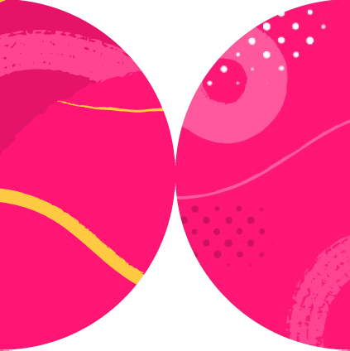

Learning Advanced Actions

Slide 2
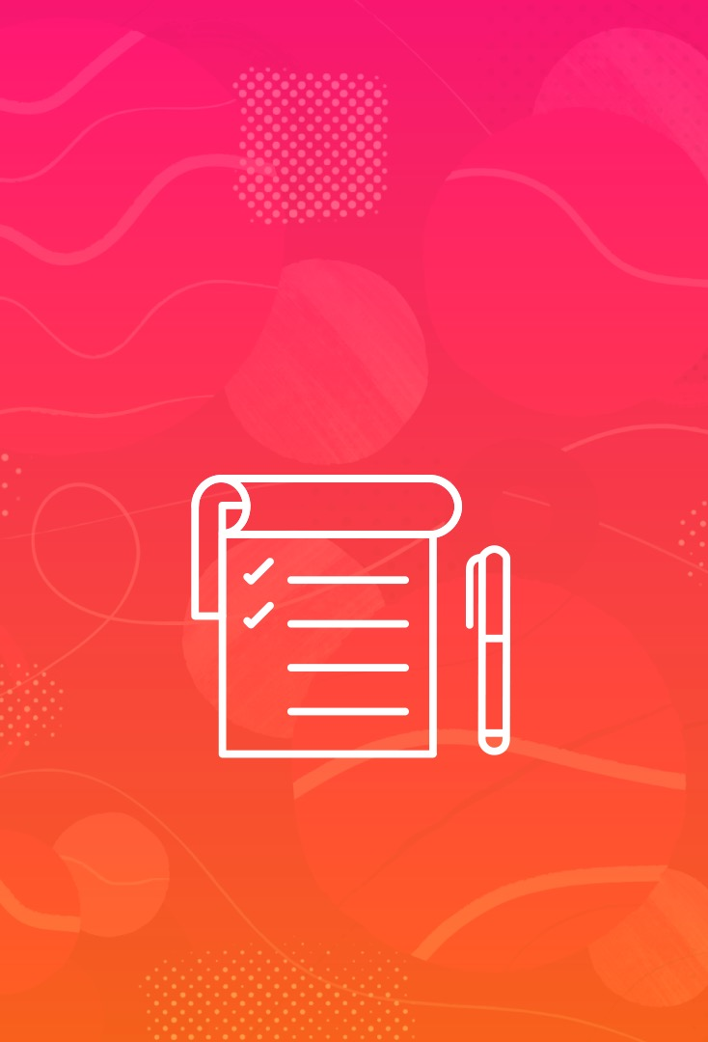
Dialogs (JavaScript pop-ups)
Download and upload files
Console events and errors Cookies and browser storage Run custom JavaScript
Screenshots Authentication
Multi-page scenarios
Overview

Slide 3

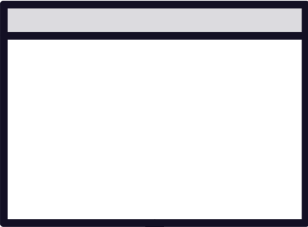
Dialogs
Alert OK
Confirm OK-Cancel
Prompt Input + OK/Cancel

Slide 4

Playwright dismisses dialogs by default

Slide 5

@BeforeEach void setup() {
// log in
}
@Test
void someTest() {
// need to be logged in
}
@AfterEach
void cleanup() {
// log out
}

Slide 6
inject authenticated state
BrowserContext
BrowserContext
@Test
void authenticatedTest1() {
// steps
}
@Test
void authenticatedTest2() {
// steps
}

Slide 7


Downloads
Verify that:
Link is valid
File is the correct one
How to verify a successful download?

Slide 8

Downloads in Playwright
Deleted after browser context closure
Test terminated half-way? No clean up.

Slide 9

Downloads
Non-previewable files
In headed and headless
Previewable
Headless only

Slide 10
Multi-page Scenario
Shared state: single user
Page | page1 | = | ctx.newPage();
Page | page2 | = | ctx.newPage();

Slide 11
Multi-user Scenario
User 1
Page | page1 | = | ctxOne.newPage();
Page | page2 | = | ctxTwo.newPage(); User 2
page1.getBySomeLocator(...).click(); page2.reload();

Slide 12
Playwright dismisses dialogs by default
page.on______(do_thing)
Summary
API for cookies
page.evaluate(“custom_js”) Capture and reuse auth state
Downloads can be tricky page.screenshot(your config)

